Slide 1

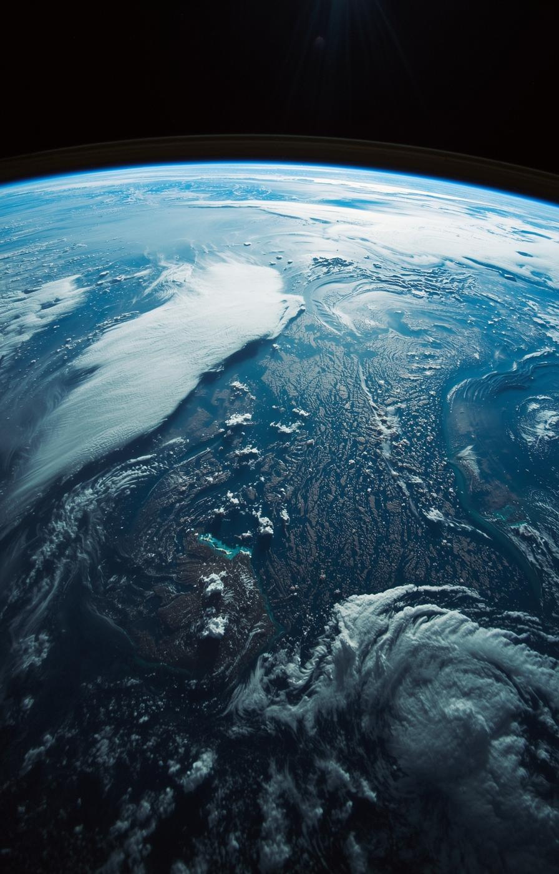

How Climate Change Is Impacting the Global Ecosystem
Name:Raiyan Mugdho
ID:2211394042
Course : ENG111
Faculty : SZN

Slide 2

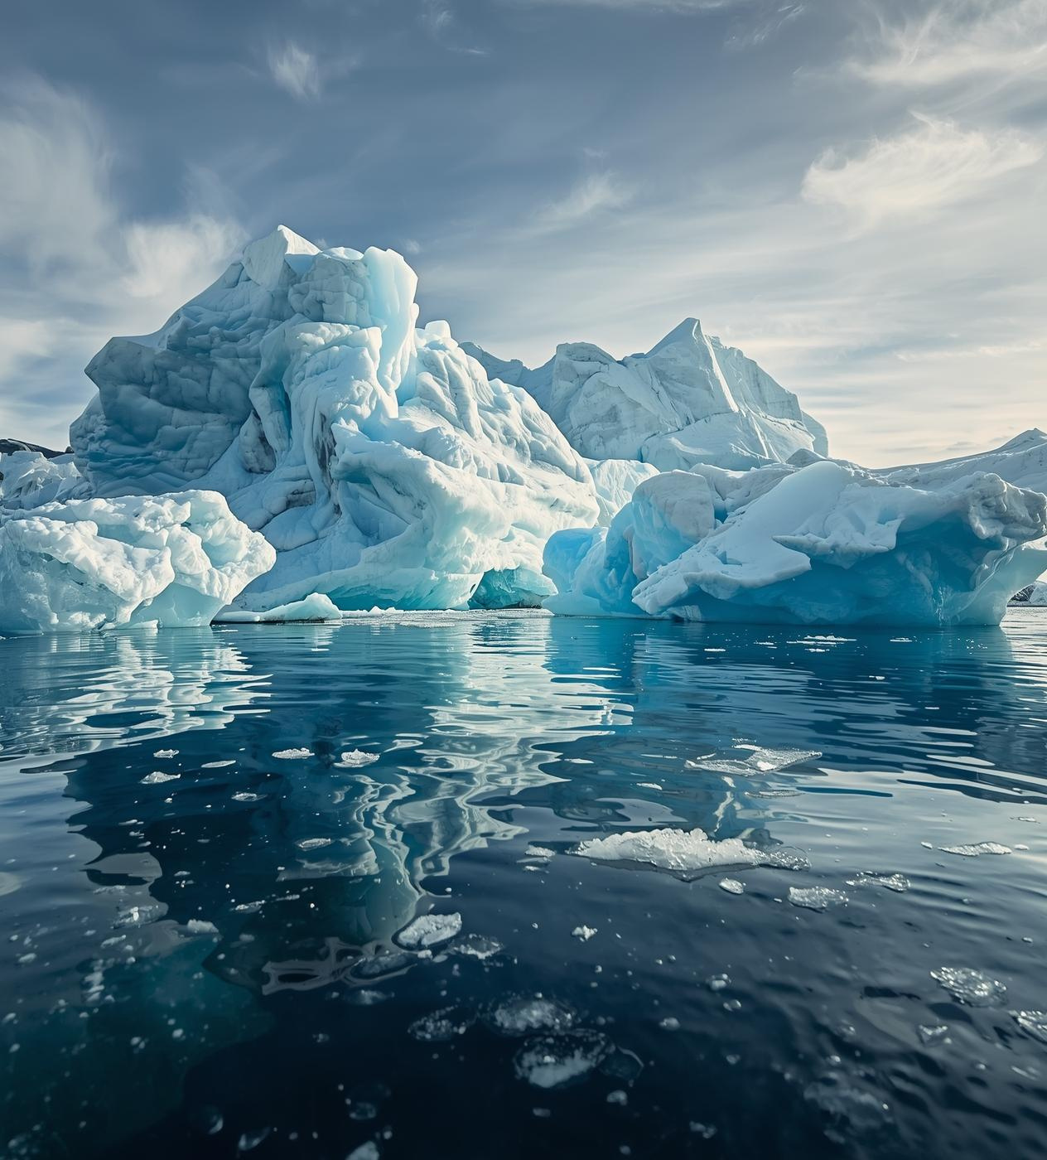
Understanding Climate Change
Climate Change
Greenhouse Gases
Global Temperature Rise
Resulting Effects

Slide 3

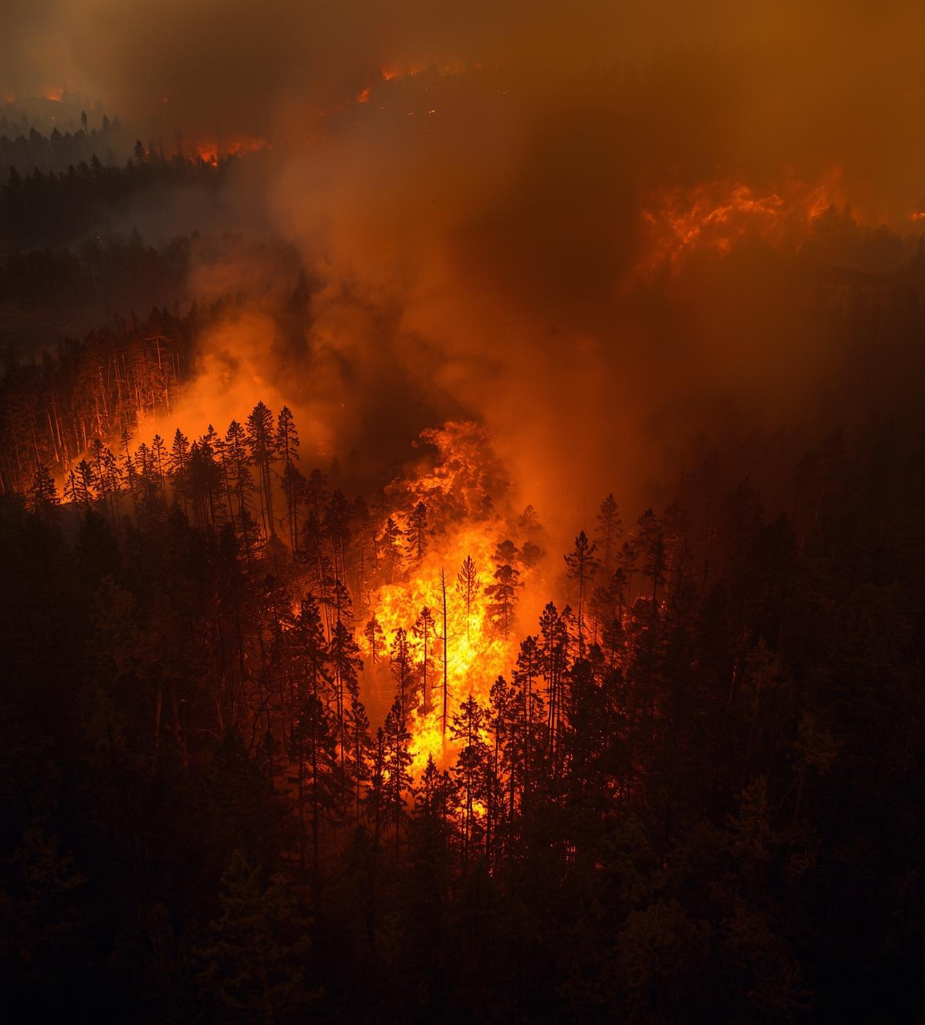
Effects on Biodiversity
Disruption of Habitats
Forest Fires & Deforestation
Loss of Pollinators

Slide 4

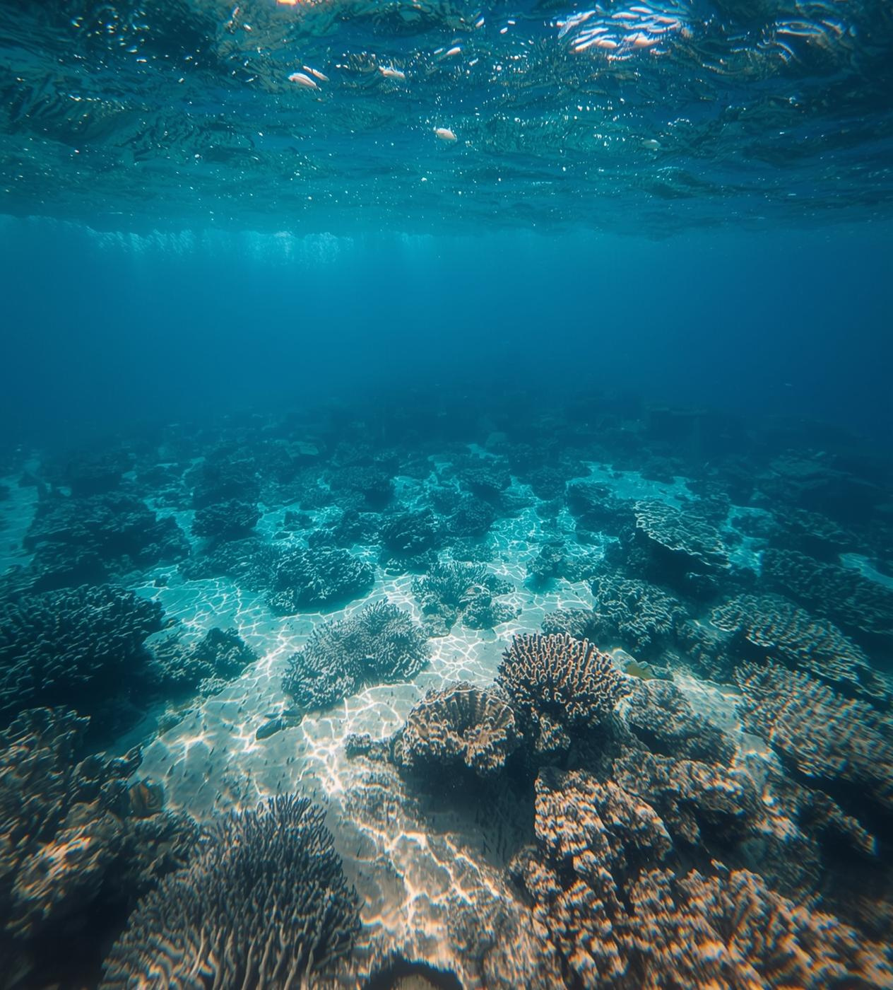
Effects on Oceans and Marine Life
Rising Sea Temperatures
Ocean Acidification
Disrupted Food Chains

Slide 5

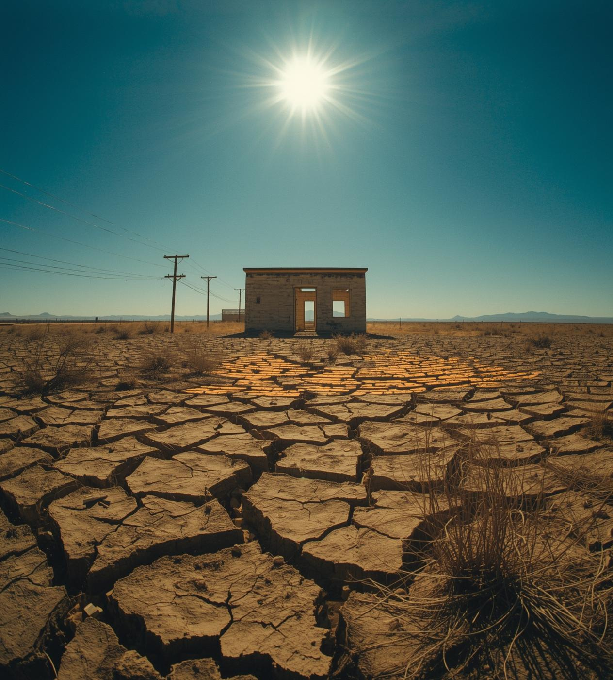
Effects on Human Societies
Extreme Weather Events
Food & Water Insecurity
Health Impacts
Economic Burden

Slide 6

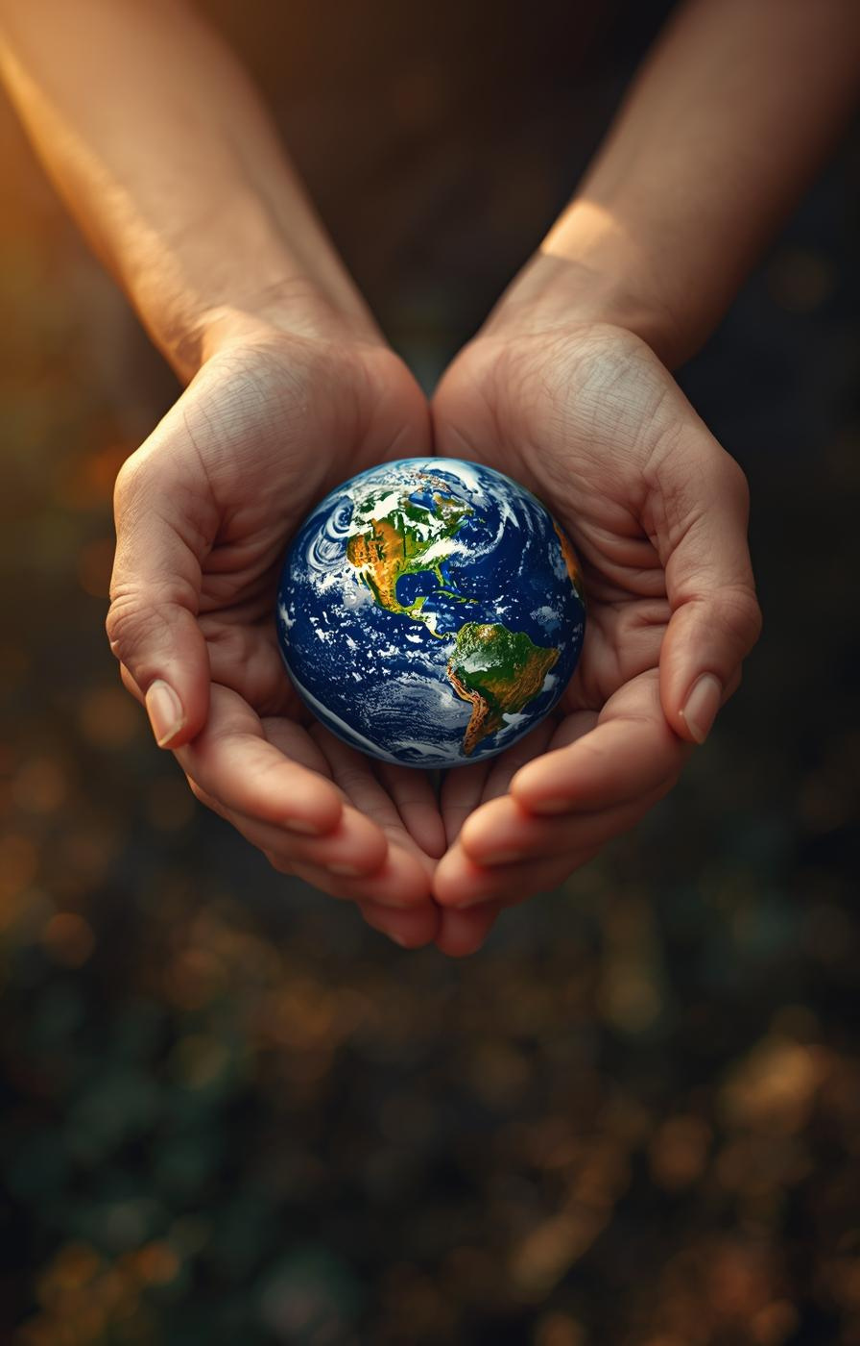
“We do not inherit the Earth from our ancestors; we borrow it from our children.”
Caring for our planet together

